Slide 1

TMDB Movie Data Analysis
By Bharathwaj

Slide 2
Description:
Movies that cost over $100 million can still fail, why so? Movie lovers might have different interests.
A production company wants to analyze a movie dataset to identify what kind of movies perform well in cinemas, which genres they belong to, and so on. It will help the company predict if a movie will be a commercial success, if the movie will be highly rated, etc.

Slide 3
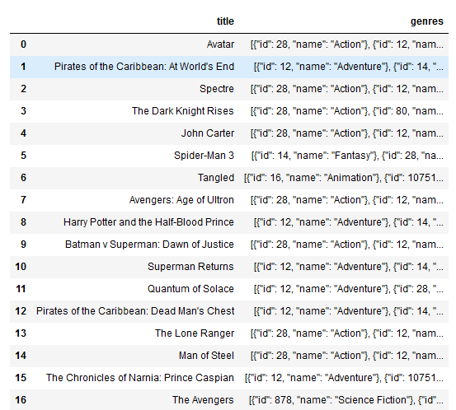
Loading data into python notebook and displaying first 50 movies from dataset:
First loaded the dataset into python jupyter notebook.
By using info() function we got the columns and rows details.
For fetching title, genres of first 50 movies from dataset used head() function.

Slide 4
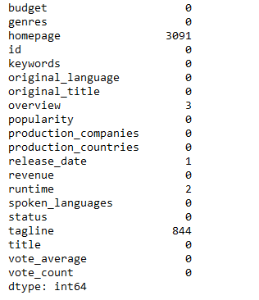
Identifying nulls and performing null value treatment:
Identified the nulls in the dataframe using isnull().sum() function.
Replaced the null values with the mode using fillna() function.

Slide 5
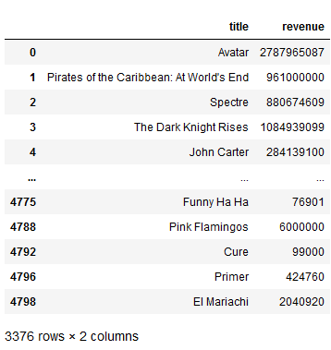
Removing the rows with value 0 from budget and revenue columns:
For removing the values 0 from both columns I have used drop function with a condition so that it will drop the values that are zero.

Slide 6
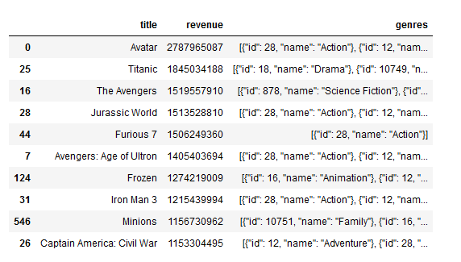
Top 10 movies based on revenue:
Here we can see avatar is top movie with the highest revenue generated and it is Action genre.

Slide 7
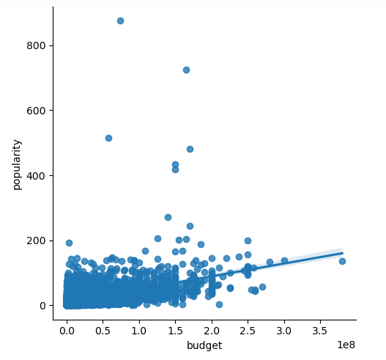
Popularities of movies related with movie budget:
Yes the popularity of movie is related to budget.
As we can see as budget increase popularity also increasing.

Slide 8
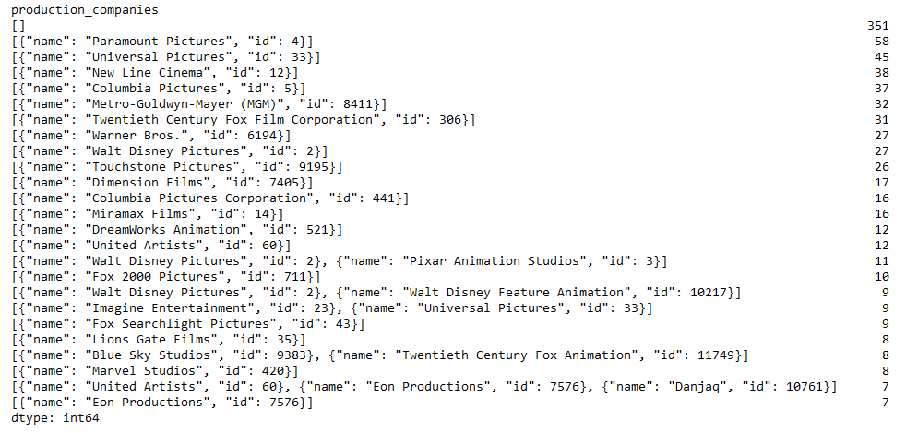
Top 25 production companies based on the number of movies they have produced:
Here taken the count of all production companies using value counts function.
We can see paramount picture production company has highest number of movies with 351

Slide 9
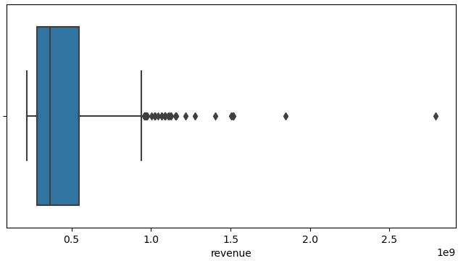
Identifying outliers:
Here we can see there are outliers on the upper fence of the graph.
For removing the outliers used IQR method.

Slide 10
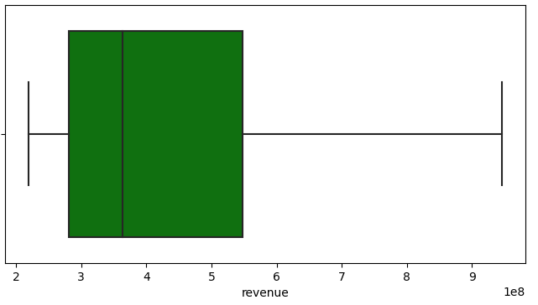
After removing outliers:
From the graph we can see that outliers are removed.

Slide 11

Conclusion:
The production companies need to focus more on action films because we can see more action films are there in top 10 films revenue.
They need to focus more on Action, Adventure and Science fiction films so that it may run good in the box office.

Slide 12
Thank you

